Slide 1
Building a spam classifier

Slide 2
Prioritizing What to Work On
Spam (1)
Non-spam (0)
From: cheapsales@buystufffromme.com
To: ang@cs.stanford.edu
Subject: Buy now!
Deal of the week! Buy now!
Rolex w4tchs - $100
Med1cine (any kind) - $50
Also low cost M0rgages available.
From: Alfred Ng
To: ang@cs.stanford.edu
Subject: Christmas dates?
Hey Andrew,
Was talking to Mom about plans for Xmas. When do you get off work. Meet Dec 22?
Alf

Slide 3
Prioritizing What to Work On
Spam (1)
Non-spam (0)
From: cheapsales@buystufffromme.com
To: ang@cs.stanford.edu
Subject: Buy now!
Deal of the week! Buy now!
Rolex w4tchs - $100
Med1cine (any kind) - $50
Also low cost M0rgages available.
From: Alfred Ng
To: ang@cs.stanford.edu
Subject: Christmas dates?
Hey Andrew,
Was talking to Mom about plans for Xmas. When do you get off work. Meet Dec 22?
Alf

Slide 4
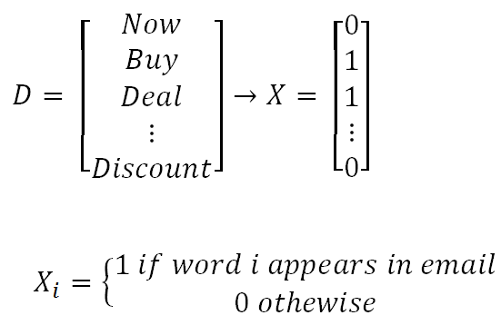
Prioritizing What to Work On
Building a spam classifier:
Supervised learning: x = features of email, y= spam (1) or not spam (0)
Feature x: Choose 100 words indicative of spam / not spam
Eg: deal, now, buy, discount, …
In practice, take most frequently occurring n words (10000 to 50000)

Slide 5
Prioritizing What to Work On
Different ways we can approach a machine learning problem:
Collect lots of data
Develop sophisticated features (for example: using email header data in spam emails)
Develop algorithms to process your input in different ways (recognizing misspellings in spam).

Slide 6
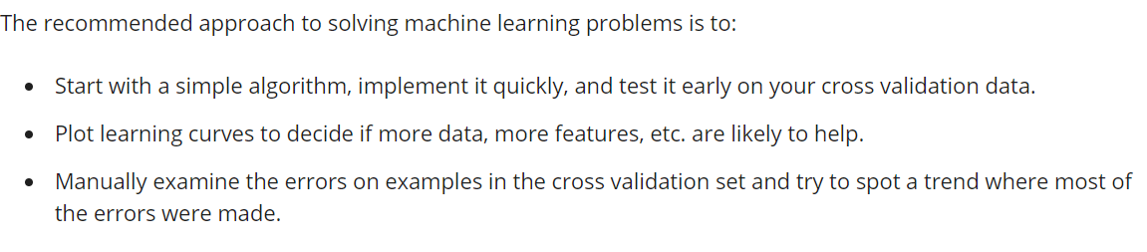
Error Analysis

Slide 7
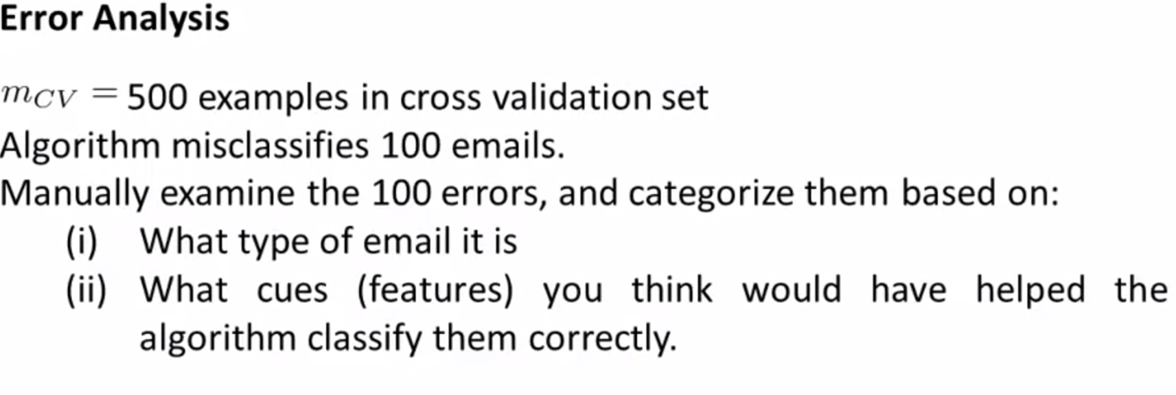
Pharma: 12
Replica/fake: 4
Steal password: 53
Other: 31
Deliberate misspellings: (m0rgage, med1cine, etc.): 5
Unusual email routing: 16
Unusual (spamming) punctuation: 32

Slide 8
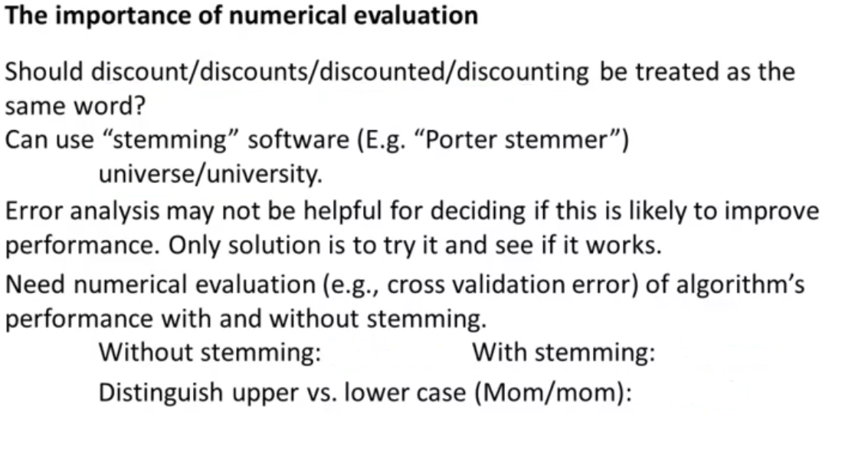
5% error
3% error
3.2% error
It is very important to get error results as a single, numerical value. Otherwise it is difficult to assess your algorithm's performance. For example if we use stemming, which is the process of treating the same word with different forms (fail/failing/failed) as one word (fail), and get a 3% error rate instead of 5%, then we should definitely add it to our model. However, if we try to distinguish between upper case and lower case letters and end up getting a 3.2% error rate instead of 3%, then we should avoid using this new feature. Hence, we should try new things, get a numerical value for our error rate, and based on our result decide whether we want to keep the new feature or not.

Slide 9
Error Metrics for Skewed Classes
Skewed classes basically refer to a dataset, wherein the number of training example belonging to one class out-numbers heavily the number of training examples beloning to the other.
Consider a binary classification, where a cancerous patient is to be detected based on some features. And say only 1 of the data provided has cancer positive. In a setting where having cancer is labelled 1 and not cancer labelled 0, if a system naively gives the prediction as all 0’s, still the prediction accuracy will be 99%.
Therefore, it can be said with conviction that the accuracy metrics or mean-squared error for skewed classes, is not a proper indicator of model performance. Hence, there is a need for a different error metric for skewed classes.

Slide 10
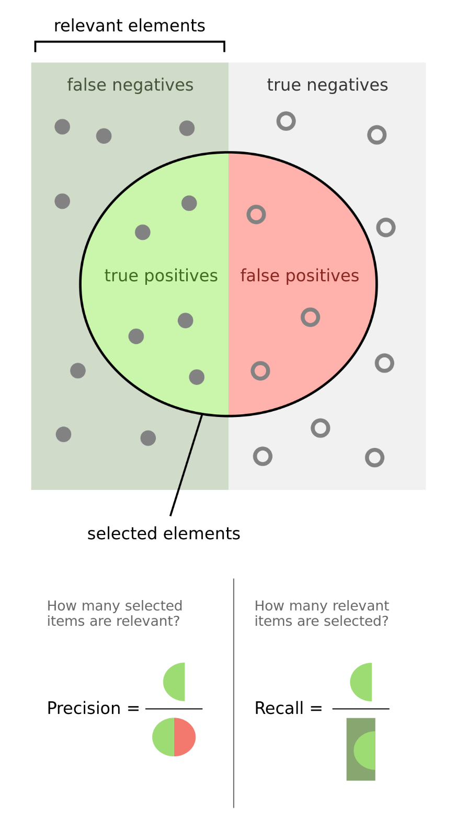
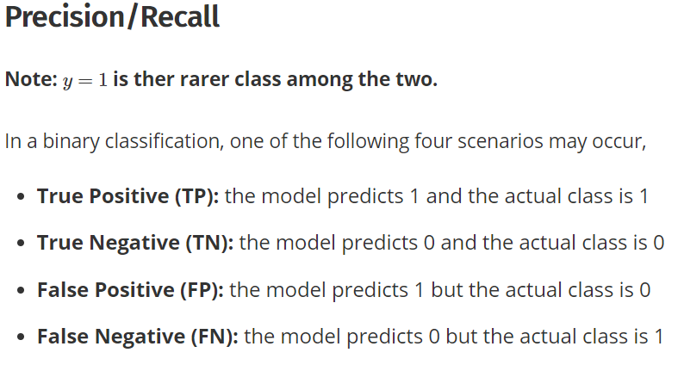
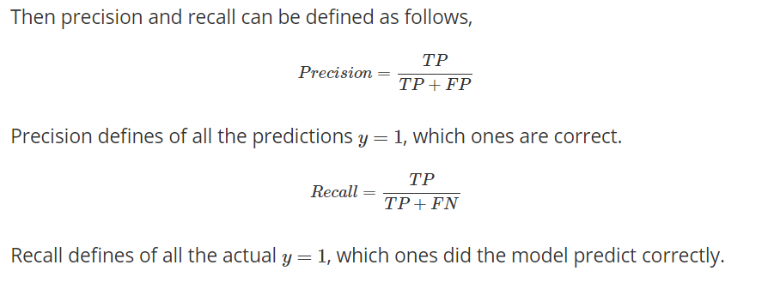

Slide 11
Trading off precision and recall
Thang Nguyen

Slide 12
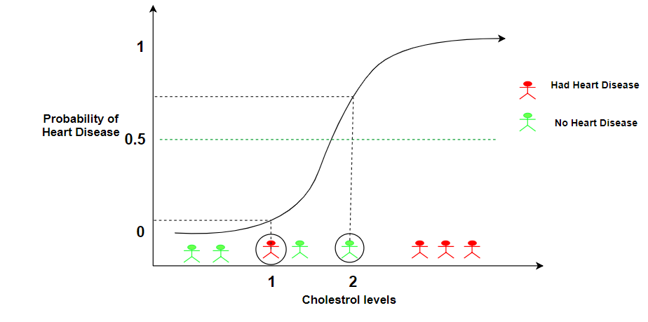


Precision and recall
Logistic regression:
Predict 1 if
Predict 0 if
Threshold

Slide 13
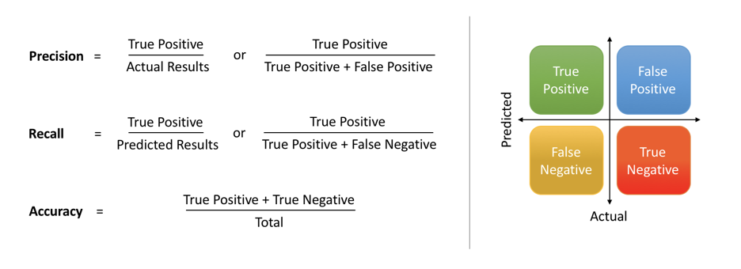
Precision and Recall

Slide 14
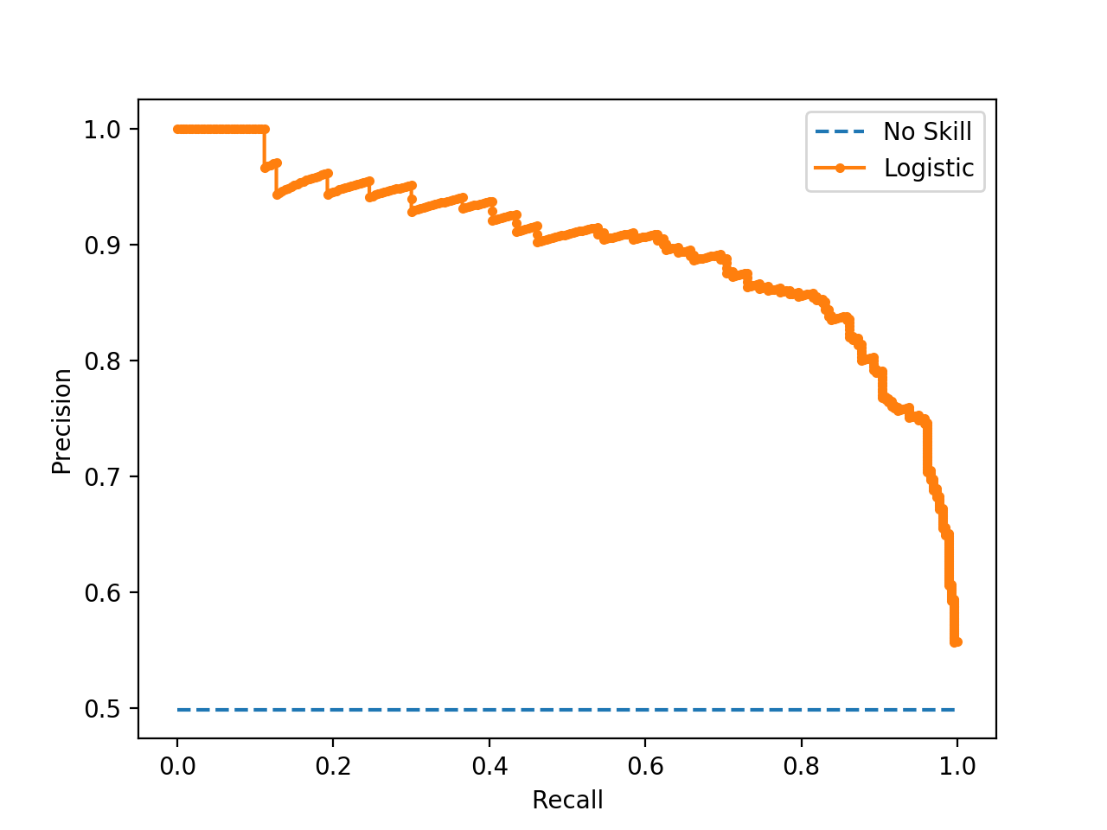
Precision and Recall

Slide 15
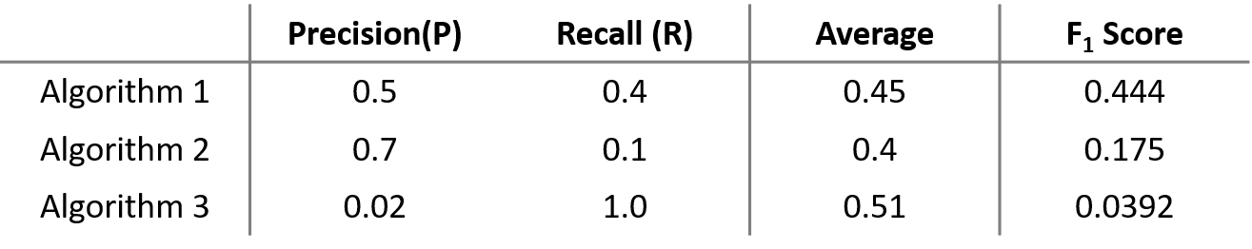
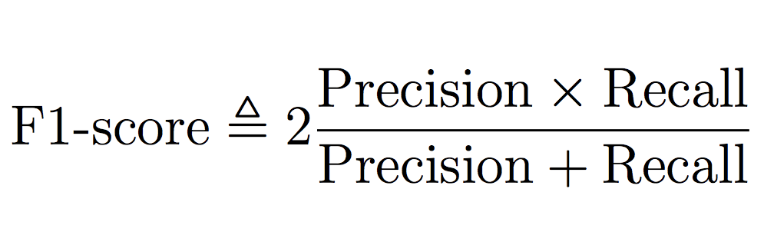
F1 score
Example
F1 score = harmonic mean of Precision and Recall

Slide 16
Using Large Data Sets

Slide 17
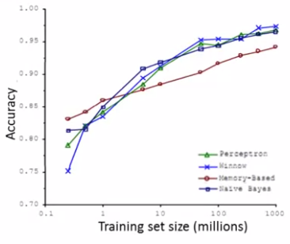
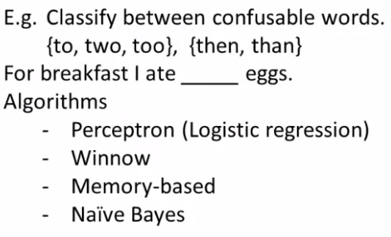
Data For Machine Learning
Design a high accuracy learning system
More Data -> Better Performance

Slide 18
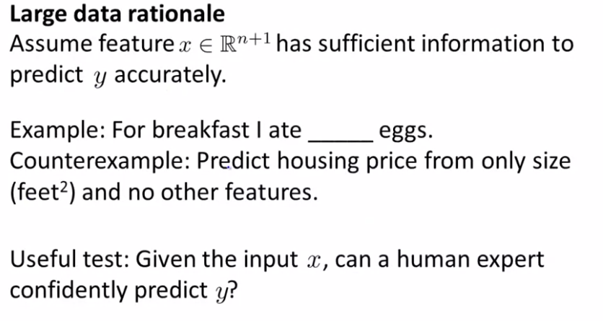
Data for Machine Learning
Human expert can confidently predict missing word => Feature x may predict y correctly
two
Human expert cannot predict accurately using only size => Need more features

Slide 19
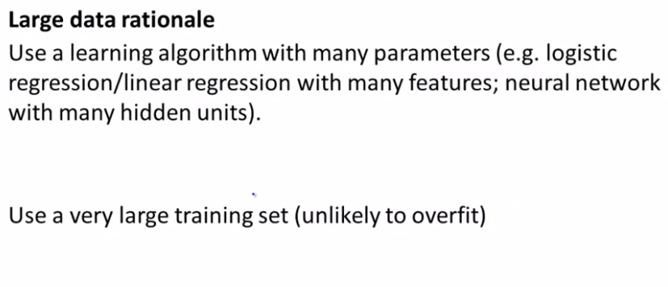
Data for Machine Learning

